Slide 1
Cell Phone-A Thief In Your Pocket
Group Member: Jiajun Guo, Sihan Xu, Stephanus Huang

Slide 2
A BRIEF HISTORY OF DATA COLLECTION
Phase 1 (3000 B.C. – present) – collecting data on paper
Phase 2 (1989 – present) – replacing paper with computer
Phase 3 (~2010 – present) – computer and mobile devices

Slide 3
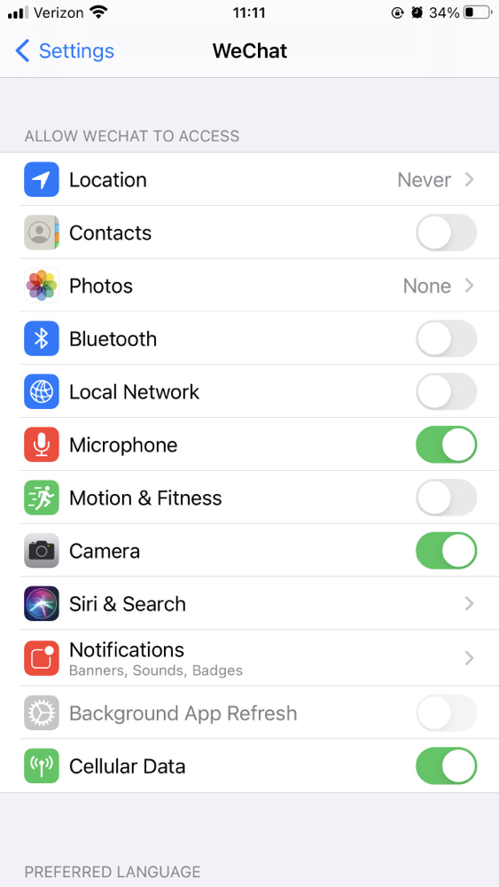
Mobile Applications
Your location
Contacts
Photos or video
Text messages and e-mails
Passwords
Financial data
Microphone
Call information

Slide 4
Consequences of this information

Slide 5
Scam
Contracts
Call information
Text messages and e-mails
Any photos or video you take on your phone

Slide 6
Accurate Advertising
Search History Financial data
Location Personal informations
Microphone

Slide 7
Monitoring
Microphone
Camera

Slide 8
A Porn Star
Any photos or video you take on your phone
Details about the text messages and e-mails you send and receive

Slide 9
Preventions as a User

Slide 10
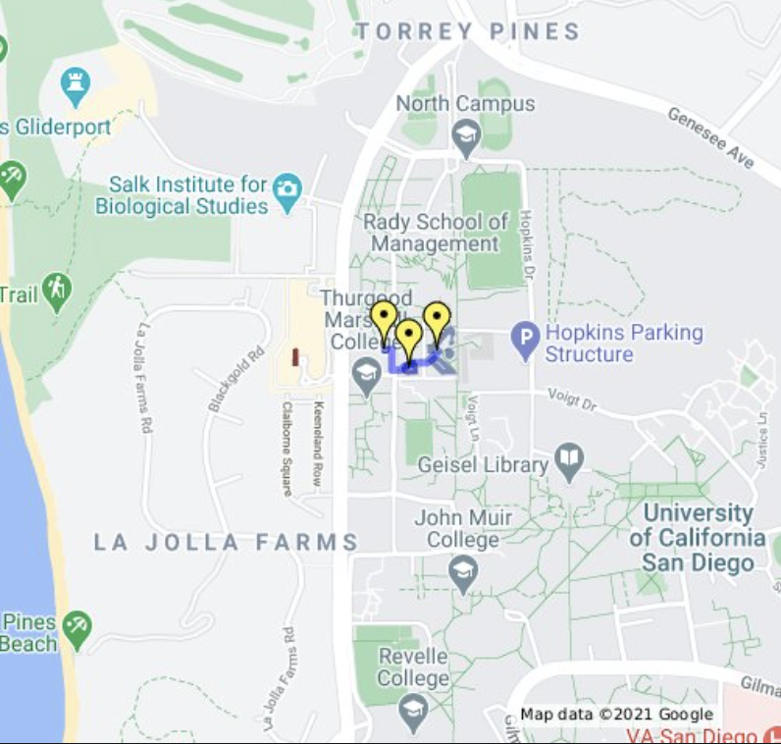
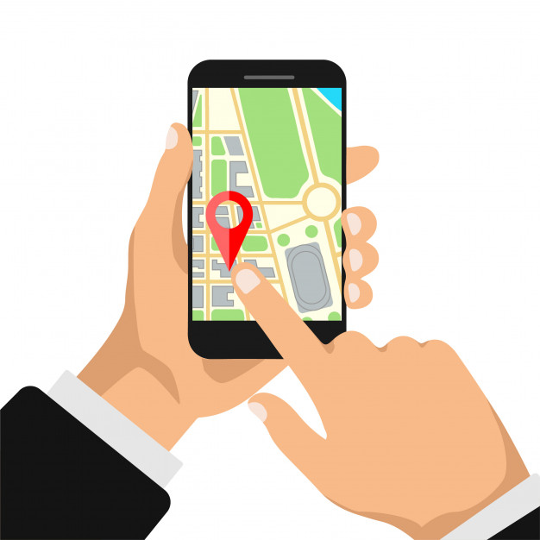
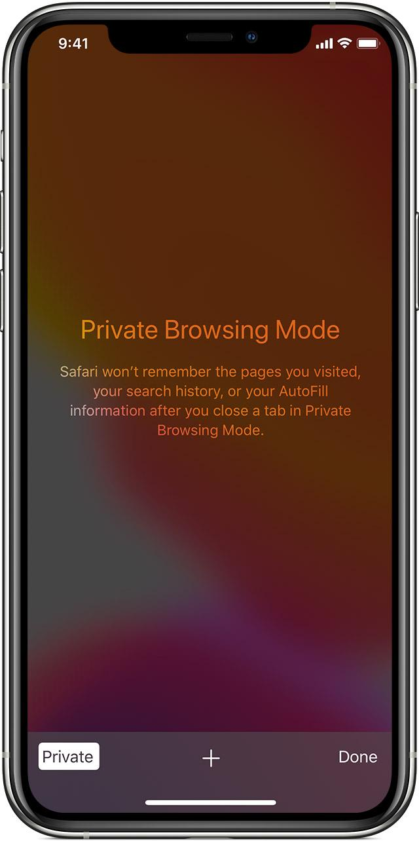
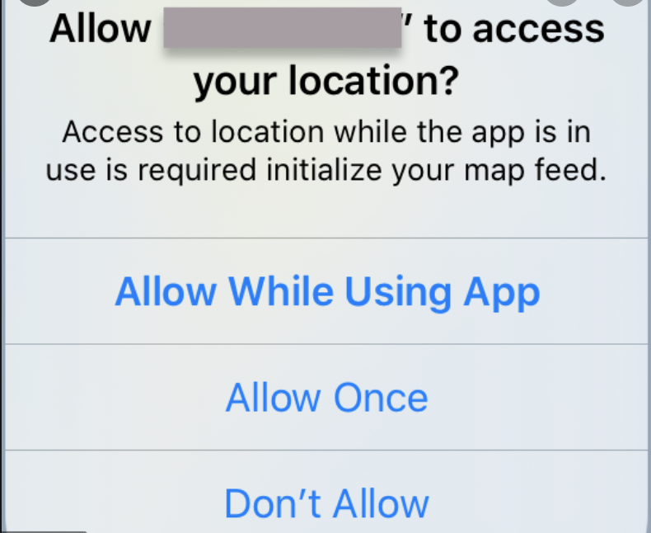
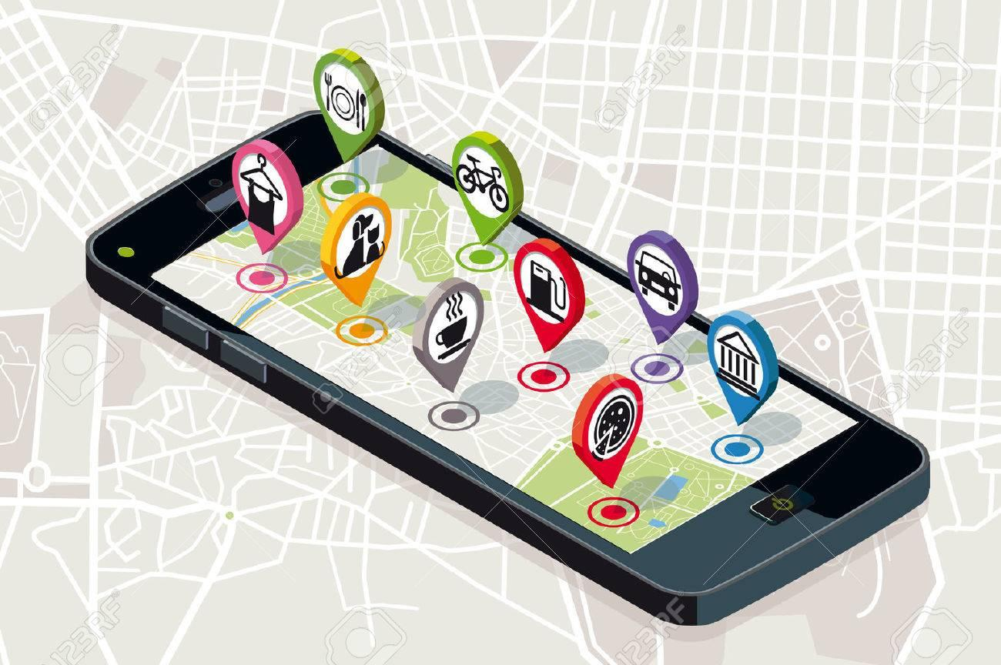
Turn Off Location access
Use Private browser
This will disable all hidden map trackers
This helps to block advertising, analytics and social trackers.

Slide 11
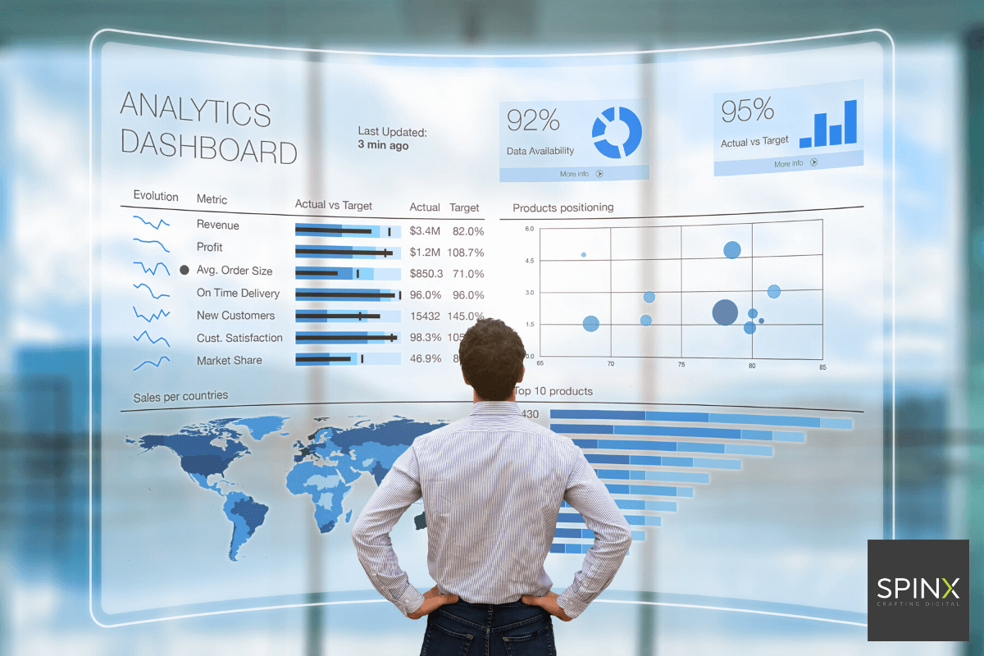

Limit advertising Tracking
Becareful on Wi-Fi networks
This limits a company ability to track our personal internet searches.
Open for hackers to gain access to our personal information.

Slide 12
Prevention as a Programmer

Slide 13
Data Collect
As less as we can
Notification when we collect the data.

Slide 14
Connections with ACM Code of Ethics

Slide 15
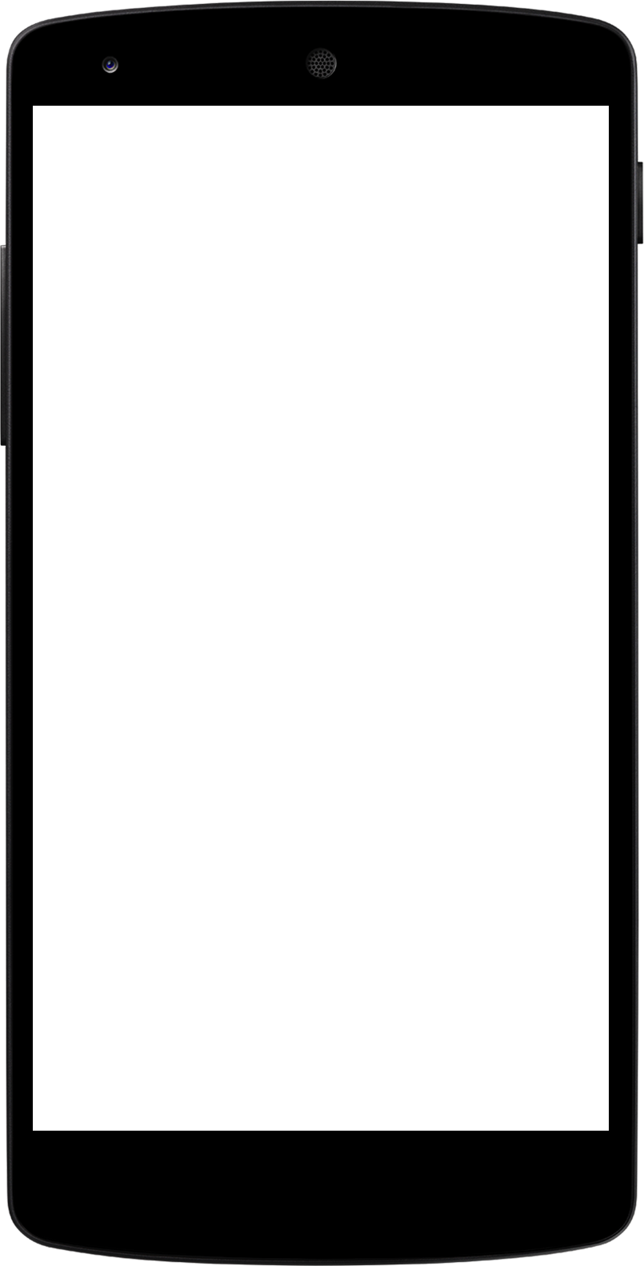
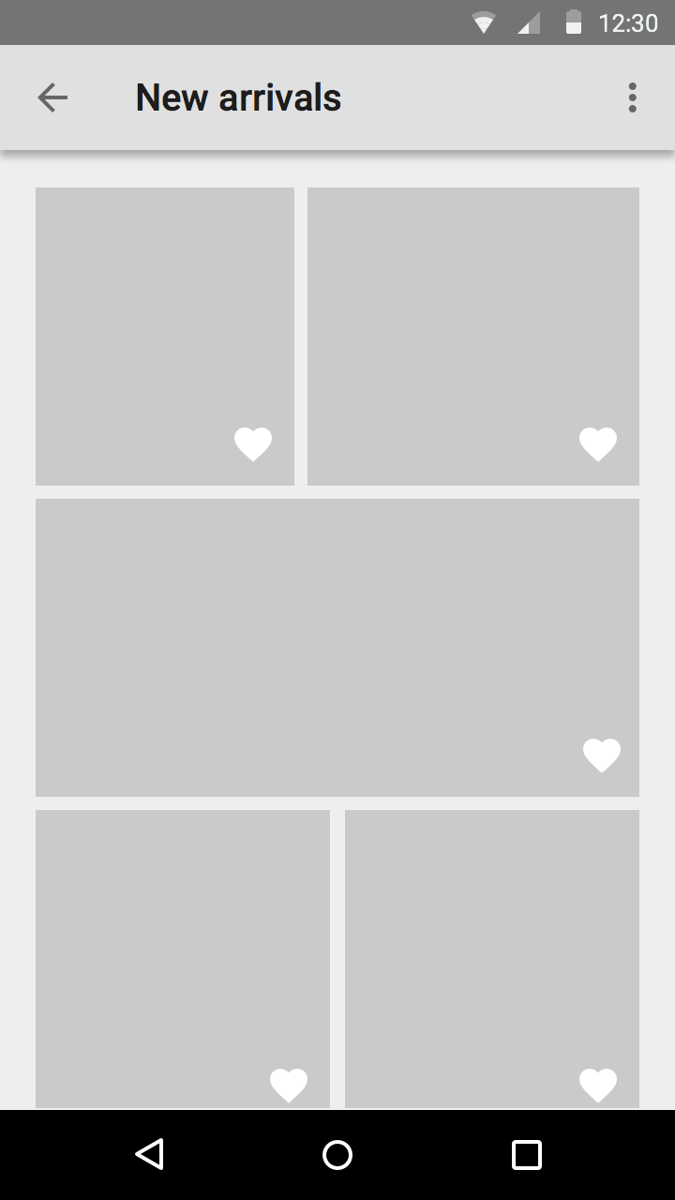
General Ethical Principles
1.6 Respect Privacy
-> Do not used information gathered without consent.
1.7 Honor Confidentiality
-> Should protect confidentiality of client

Slide 16
Professional Responsibilities
2.2 Give comprehensive and thorough evaluations of computer systems and their impacts, including analysis of possible risks
-> Identify potential risks in the system
2.9 Design and implement systems that are robustly and usable secure
-> System should function as intended
-> Prevent data breaches

Slide 17
Professional Leadership Principles
3.1 Ensure that the public good is the central concern during all professional computing work
-> System created has to focus on public good.

Slide 18
References
[1] C. Kent, ”The Conversation,” 2018, https://theconversation.com/smartphone-data-tracking-is-more-than-creepy-heres-why-you-should-be-worried-91110.
[2] K. Komando, “USA Today,” 2019, https://www.usatoday.com/story/tech/columnist/komando/2019/02/14/your-smartphone-tracking-you-how-stop-sharing-data-ads/2839642002/
[3] “Association for Computing Machinery,” 2018, https://www.acm.org/code-of-ethics
[4] “MOBILE DATA COLLECTION - How Big Data Is Collected,” 2018, https://www.magpi.com/what-is-mobile-data-collection

Slide 19
Thank you!

